Slide 1
Operating Systems
IPC: Inter-processes Communication
Vassilis Markos,
Mediterranean College
Week 11

Slide 2
UDP

Slide 3
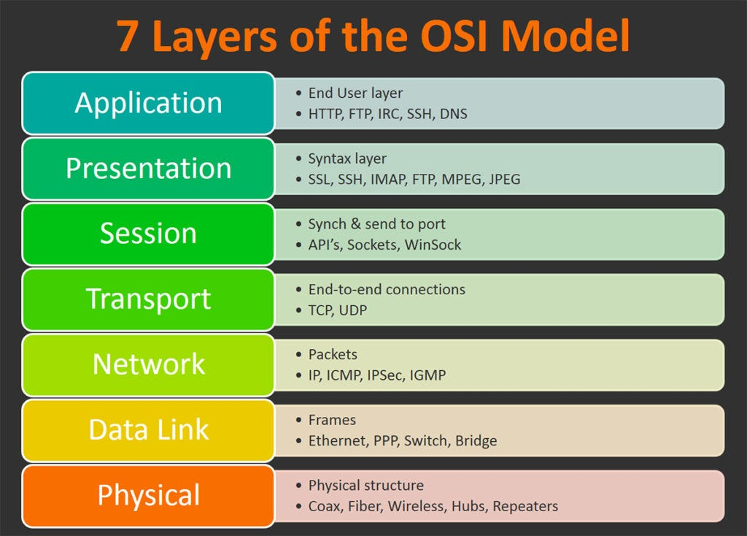
(Reminder) Open Systems Interconnection (OSI)
The top 4 layers are the Host Layers.
The bottom 3 layers are the Media Layers.
Sometimes, we split the 2nd layer (Data Link) to two sublayers: LLC and MAC.
Borrowed from: https://int0x33.medium.com/day-51-understanding-the-osi-model-f22d5f3df756

Slide 4
Relevant Concepts
Data segmentation?
  The practice of splitting up larger chunks of data to smaller bits.
  Why?
  Because packets have a fixed max size (usually 1518B) to avoid a single infinite packet blocking the internet forever.
Ports?
  Logical entities corresponding to different services (e.g. 80 → WWW)
  Why?
  Because we need more than one processes / services to run at the same time → DO NOT confuse with physical ports (i.e., holes)

Slide 5
Port Ranges
0 – 1023 → Just don’t use them!
  Reserved by the system for its own business.
  Known as “well known ports”.
1024 – 49151 → “Registered ports”
  Uniquely identified services.
  Use but cautiously.
49152 – 65535:
  Private / Dynamic ports
  Use as you wish.
Why 65535?
  65535 = 2^(16) - 1…
  … we use 16 bits to define a port.

Slide 6
Conversation Multiplexing
Imagine you have two large messages, A, and B. What are the pros and cons of:
  Sending first A and then B (or vice versa)?
  What if A is urgent?
  What if both are urgent?
How can the use of ports + data segmentation help you on that?
Conversation multiplexing:
  When two or more “conversations” are executed simultaneously by:
    spitting each message into smaller chunks (segmentation), and;
    sharing each chunk with the correct receiver (port).
This is, essentially, one of the main jobs of Layer 4.

Slide 7
TCP / UDP
There are two main ways to implement Layer 4 functionality:
Transmission Control Protocol (TCP):
  Connection oriented and reliable → 3-way handshake.
  All messages have a reply.
  Useful ports to remember: 21 (FTP), 25 (SMTP), 53 (DNS), 80 (HTTP), 110 (POP3), 443 (HTTPS).
User Datagram Protocol (UDP):
  Connectionless and Unreliable (do these sound familiar?)
  Useful ports to remember: 53 (DNS), 69 (TFTP), 161 (SNMP)

Slide 8
TCP vs UDP
TCP creates a session while UDP does not.
TCP retransmits any lost or corrupt data, while UDP does ont.
TCP numbers data segments while UDP does not.
TCP records message exchanges.
TCP regulates the amount of data transmission.
UDP sends less data.
UDP does not wait for a reply.
UDP does not expect and acknowledgement (ACK).
UDP sends the next segment once ready (no checks of arrival).
TCP favours reliability and connections while UDP favours speed.

Slide 9
Why even use UDP?
You’re talking through VoIP. A voice packet is lost. So, what to do next?
  Resend it at a later time?
  Ignore it?
You’re playing an online video game. A data packet is lost, so some frames might be missing. So, what to do next?
  Resend it at a later time?
  Ignore it?
UDP is useful in such cases, where you can tolerate some data loss.
Also used by services that add delay on a network:
  Domain Name System (DNS)
  Simple Network Management Protocol (SNMP)
  Dynamic Host Configuration Protocol (DHCP)

Slide 10
Okay, so why use TCP, then?
You’re watching a Packet Tracer tutorial. Some packets are lost. So, what to do next?
  Resend them to the buffer?
  Ignore them?
You are downloading a large file in three parts. Some packets have been lost.
  Resend them?
  Ignore them?
There are cases when speed matters less than reliability. In such cases, TCP is preferred over UDP.

Slide 11
TCP 3-Way Handshake
Walking on the street, you see a stranger. You fill an inexplicable urge to talk to them:
[You] Hey!
[Them] What?!
[You] Wanna talk…
The same takes place in a 3-Way Handshake:
SYN message: Ask to talk with the recipient (knock-knock).
SYN, ACK message: Accept the request (“Who’s it?”).
ACK message: Inform the recipient we want to start a conversation (“It’s me!”).
Play around with Wireshark → find the TCP section in an appropriate transaction.

Slide 12
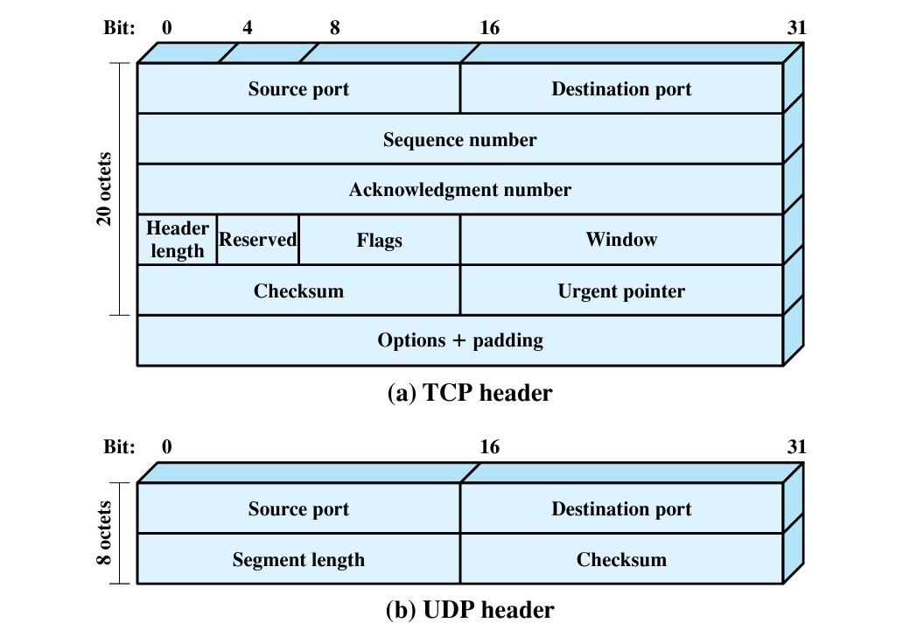
TCP / UDP Headers
Source: Data and Computer Communications, 8th Edition, p. 39, Fig. 2.3

Slide 13
UDP Header
The UDP header is really simple, because UDP is a connectionless and unreliable protocol that builds on top of IP, which is…
…a connectionless and unreliable protocol.
This is why it actually needs to add such a small header on top of the IP(v4/v6) header.
Also, the checksum algorithm is the same as with TCP and IP, i.e.:
  It adds a temporary pseudoheader;
  It computes the required checksum value for the provided message;
  It cross–checks with the header checksum and, if it is invalid, it drops the packet.

Slide 14
Epilogue: More Examples Use Cases Of UDP
Inward data collection: Involves the periodic active or passive sampling of data sources, such as sensors, and automatic self-test reports from security equipment or network components. In a real-time monitoring situation, the loss of an occasional data unit would not cause distress, because the next report should arrive shortly.
Outward data dissemination: Includes broadcast messages to network users, the announcement of a new node or the change of address of a service, and the distribution of real-time clock values.

Slide 15
Epilogue: More Examples Use Cases Of UDP
Request-response: Applications in which a transaction service is provided by a common server to a number of distributed TS users, and for which a single request-response sequence is typical. Use of the service is regulated at the application level, and lower-level connections are often unnecessary and cumbersome.
Real-time applications: Such as voice and telemetry, involving a degree of redundancy and/or a real-time transmission requirement.These must not have connection-oriented functions such as retransmission.

Slide 16
When Videos Go Viral…
Imagine for a while a video streaming platform, e.g., YouTube.
Also, imagine a really viral video, e.g., one involving cats.
Now, assume you are a server of this video streaming platform.
  How do you feel?
  Probably stressed…
Servers are often asked to retransmit the same pieces of information over several clients.
This, evidently results to a lot of traffic, and a lot of repetition.
How could we avoid that?

Slide 17
Lifting The Weight Off A Server
Can you think of a way to make a poor server feel a bit better?
Well, one way would be to group recipients of the same content together.
So, essentially, much like how email groups or group chats work.
  We put recipients of the same content together into the same group.
  We share the content we want to share into that group once.
  All recipients receive a copy of that message at once.
Why not do the same thing with our poor server?
  But, then, what are groups in our case and how to actually create them?
  Any ideas?

Slide 18
Multicast: A UDP Special
What we have described above is exactly the idea behind multicast.
Multicast is essentially the practice of sending the same information to a group of users within a network once and having all members of that group share a copy.
This is a UDP specific functionality, since we need the connectionless nature of UDP.
  Which means, we essentially pass any trouble to the clients.
  But, well, we cannot have it all at once…

Slide 19
Linux Sockets

Slide 20
System Sockets On Linux
At the system level, we have several processes that simultaneously.
Typically processes interact for a few times in a row and then switch to do other stuff such as interact with other processes.
So, which would you prefer, TCP or UDP?
  TCP will add an overhead to all communications to establish connections.
  UDP will just share the data.
  So, UDP, at this level offers some speed that TCP simply cannot.
  Also, UDP can be eventually more reliable in such cases, since it will not break communication in case of failure — it will just keep sharing data.

Slide 21
A Simple Example (server)
#include <stdio.h>
#include <stdlib.h>
#include <string.h>
#include <unistd.h>
#include <sys/socket.h>
#include <netinet/in.h>
#define PORT 8080
int main() {
int sockfd;
char buffer[1024];
struct sockaddr_in servaddr, cliaddr;
// Creating socket file descriptor
if ((sockfd = socket(AF_INET, SOCK_DGRAM, 0)) < 0) {
perror("socket creation failed");
exit(EXIT_FAILURE);
}
memset(&servaddr, 0, sizeof(servaddr));
memset(&cliaddr, 0, sizeof(cliaddr));
// Filling server information
servaddr.sin_family = AF_INET; // IPv4
servaddr.sin_addr.s_addr = INADDR_ANY;
servaddr.sin_port = htons(PORT);
// Bind the socket with the server address
if (bind(sockfd, (const struct sockaddr *)&servaddr, sizeof(servaddr)) < 0) {
perror("bind failed");
exit(EXIT_FAILURE);
}
int len, n;
len = sizeof(cliaddr); //len is value/result
n = recvfrom(sockfd, (char *)buffer, 1024,
MSG_WAITALL, ( struct sockaddr *) &cliaddr,
&len);
buffer[n] = '\0';
printf("Client : %s\n", buffer);
sendto(sockfd, (const char *)"Hi", strlen("Hi"),
MSG_CONFIRM, (const struct sockaddr *) &cliaddr,
len);
printf("Hello message sent.\n");
close(sockfd);
return 0;
}

Slide 22
A Simple Example (client)
#include <stdio.h>
#include <stdlib.h>
#include <string.h>
#include <unistd.h>
#include <sys/socket.h>
#include <netinet/in.h>
#define PORT 8080
#define MAXLINE 1024
int main() {
int sockfd;
char buffer[MAXLINE];
struct sockaddr_in servaddr;
if ((sockfd = socket(AF_INET, SOCK_DGRAM, 0)) < 0) {
perror("socket creation failed");
exit(EXIT_FAILURE);
}
memset(&servaddr, 0, sizeof(servaddr));
servaddr.sin_family = AF_INET;
servaddr.sin_port = htons(PORT);
servaddr.sin_addr.s_addr = INADDR_ANY;
sendto(sockfd, (const char *)"Hello", strlen("Hello"),
MSG_CONFIRM, (const struct sockaddr *) &servaddr,
sizeof(servaddr));
printf("Hello message sent.\n");
int len, n;
n = recvfrom(sockfd, (char *)buffer, MAXLINE,
MSG_WAITALL, (struct sockaddr *) &servaddr,
&len);
buffer[n] = '\0';
printf("Server : %s\n", buffer);
close(sockfd);
return 0;
}

Slide 23
memset()
Before we proceed to socket–specific functionality, we have to first describe a useful function from the standard library: memset().
Library: Standard C library (libc, -lc)
To use: #include <string.h>
Syntax: void *memset(void s[.n], int c, size_t n);
Description: The memset() function fills the first n bytes of the memory area pointed to by s with the constant byte c.
Returns a pointer to the memory area s.

Slide 24
socket()
To use: #include <sys/types.h> and #include <sys/socket.h>
Syntax: int socket(int domain, int type, int protocol);
Description: socket() creates an endpoint for communication and returns a file descriptor that refers to that endpoint. The file descriptor returned by a successful call will be the lowest-numbered file descriptor not currently open for the process.
The domain argument specifies a communication domain; this selects the protocol family which will be used for communication. These families are defined in <sys/socket.h>.

Slide 25
socket()
Some choices for the domain argument:
  AF_UNIX: Local communication
  AF_INET: IPv4 Internet protocols
  AF_INET6: IPv6 Internet protocols
  AF_KEY: Key management protocol, originally developed for usage with IPsec
  AF_VSOCK: VSOCK (originally "VMWare VSockets") vsock(7) protocol for hypervisor-guest communication

Slide 26
socket()
The socket has the indicated type, which specifies the communication semantics. Some common types are:
  SOCK_STREAM: Provides sequenced, reliable, two-way, connection-based byte streams. An out-of-band data transmission mechanism may be supported.
  SOCK_SEQPACKET: Provides a sequenced, reliable, two-way connection-based data transmission path for datagrams of fixed maximum length; a consumer is required to read an entire packet with each input system call.
  SOCK_RAW: Provides raw network protocol access.

Slide 27
socket()
Since Linux 2.6.27, the type argument serves a second purpose: in addition to specifying a socket type, it may include the bitwise OR of any of the following values, to modify the behavior of socket():
  SOCK_NONBLOCK: Set the O_NONBLOCK file status flag on the open file description referred to by the new file descriptor. Using this flag saves extra calls to fcntl(2) to achieve the same result.
  SOCK_CLOEXEC: Set the close-on-exec (FD_CLOEXEC) flag on the new file descriptor. See the description of the O_CLOEXEC flag in open(2) for reasons why this may be useful.

Slide 28
socket()
The protocol specifies a particular protocol to be used with the socket.
Normally only a single protocol exists to support a particular socket type within a given protocol family, in which case protocol can be specified as 0.
However, it is possible that many protocols may exist, in which case a particular protocol must be specified in this manner.
The protocol number to use is specific to the “communication domain” in which communication is to take place.
For more on that: man socket

Slide 29
socket()
Returns:
  On success, a file descriptor for the new socket is returned.
  On error, -1 is returned, and errno is set appropriately.
Some errors:
  EACCES: Permission to create a socket of the specified type and/or protocol is denied.
  EINVAL: Unknown protocol, or protocol family not available OR Invalid flags in type.
  EPROTONOSUPPORT: The protocol type or the specified protocol is not supported within this domain.

Slide 30
bind()
To use: #include <sys/types.h> and #include <sys/socket.h>
Syntax: int bind(int sockfd, const struct sockaddr *addr, socklen_t addrlen);
When a socket is created with socket(2), it exists in a namespace (address family) but has no address assigned to it.
bind() assigns the address specified by addr to the socket referred to by the file descriptor sockfd.
addrlen specifies the size, in bytes, of the address structure pointed to by addr.
Traditionally, this operation is called “assigning a name to a socket”.

Slide 31
bind()
The actual structure passed for the addr argument will depend on the address family. The sockaddr structure is defined as something like:
struct sockaddr {
sa_family_t sa_family;
char sa_data[14];
}
The only purpose of this structure is to cast the structure pointer passed in addr in order to avoid compiler warnings.
Returns:
  On success, zero is returned.
  On error, -1 is returned, and errno is set appropriately.

Slide 32
recvfrom()
To use: #include <sys/types.h> and #include <sys/socket.h>
Syntax: ssize_t recvfrom(int sockfd, void *buf, size_t len, int flags, struct sockaddr *src_addr, socklen_t *addrlen);
Alternatives:
  ssize_t recv(int sockfd, void *buf, size_t len, int flags);
  ssize_t recvmsg(int sockfd, struct msghdr *msg, int flags);
The recv(), recvfrom(), and recvmsg() calls are used to receive messages from a socket. They may be used to receive data on both connectionless and connection-oriented sockets. This page first describes common features of all three system calls, and then describes the differences between the calls.

Slide 33
recvfrom()
The only difference between recv() and read(2) is the presence of flags.
With a zero flags argument, recv() is generally equivalent to read(2).
All three calls return the length of the message on successful completion.
If a message is too long to fit in the supplied buffer, excess bytes may be discarded depending on the type of socket the message is received from.
In case you are willing to dive into a vast rabbit–hole: man recvfrom

Slide 34
sendto()
To use: #include <sys/types.h> and #include <sys/socket.h>
Syntax: ssize_t sendto(int sockfd, const void *buf, size_t len, int flags, const struct sockaddr *dest_addr, socklen_t addrlen);
Alternatives:
  ssize_t send(int sockfd, const void *buf, size_t len, int flags);
  ssize_t sendmsg(int sockfd, const struct msghdr *msg, int flags);
The system calls send(), sendto(), and sendmsg() are used to transmit a message to another socket.
The send() call may be used only when the socket is in a connected state (so that the intended recipient is known). The only difference between send() and write(2) is the presence of flags. With a zero flags argument, send() is equivalent to write(2).

Slide 35
sendto()
For send() and sendto(), the message is found in buf and has length len.
For sendmsg(), the message is pointed to by the elements of the array msg.msg_iov.
The sendmsg() call also allows sending ancillary data (also known as control information).
If the message is too long to pass atomically through the underlying protocol, the error EMSGSIZE is returned, and the message is not transmitted.
For more: man sendto

Slide 36
close()
To use: #include <unistd.h>
Syntax: int close(int fd);
REMINDER: Sockets are files!
close() closes a file descriptor, so that it no longer refers to any file and may be reused.
Any record locks (see fcntl(2)) held on the file it was associated with, and owned by the process, are removed (regardless of the file descriptor that was used to obtain the lock).
Returns:
  zero on success.
  On error, -1 is returned, and errno is set appropriately.

Slide 37
Fun Time!

Slide 38
(Eventually) Your Turn: Circular Buffers
Implement a Circular Buffer as described here:
https://en.wikipedia.org/wiki/Circular_buffer
As a rough guideline, you can implement the following utilities:
A struct, Queue, that contains any required variables, counters, etc.
Push and Pop utilities, which should also take care of overflow and underflow events.
Empty and Full checking utilities.
Anything else you might find relevant.
We will make use of such circular buffers to implement a solution to the Producer Consumer problem in the next exercise.

Slide 39
Producers And Consumers
Solve the producer—consumer problem discussed above using:
The circular buffer you implemented before, and;
Semaphores.
Consider the case of a single producer and a single consumer at first, and then generalise to:
a single producer and multiple consumers;
multiple producers and multiple consumers.

Slide 40
Much Like Your Assignment…
Create a simple C function named foo() that:
takes a string as an argument;
randomly permutes its characters, stripping out any whitespace, and;
returns the mutated version of the string.
Using this as a mock “service” implement IPC between a parent process which shares a user provided string and a child process which mutates that string using foo() and returns the mutated version to the parent process. You should implement this in the following three different ways:
Using pipes.
Using shared memory + semaphores.
Using message queues.

Slide 41
Nasal Demons
It is a well known fact that the C compiler can do a lot of stuff at its own will and discretion. One of the most popular capabilities of the C compiler is that of making demons fly out of your nose. Your mission for this exercise is to:
Find out what is the relationship between nasal demons and the C compiler and summarise your findings.
Try to reproduce this behaviour — in the context of its original first appearance in this world, do not try to manipulate demons through your nose in any realistic manner!

Slide 42

Any Questions?
Office Hours:
Glydafa: Tuesday, 09:00–10:00, PC Lab
Pellinis: Wednesday, 15:00–17:00, 203
Don’t forget to fill-in the questionnaire (check right)
https://forms.gle/aj7pYsK1ksufD6xYA

